Slide 1

Global financial crisis and emerging economies: impact and responses
Valpy FitzGerald
Global Economic Recovery:
The Role of China and Other Emerging Economies
Chinese Economic Association (Europe/UK) & University of Oxford
Oxford, 12-13 July 2010

Slide 2
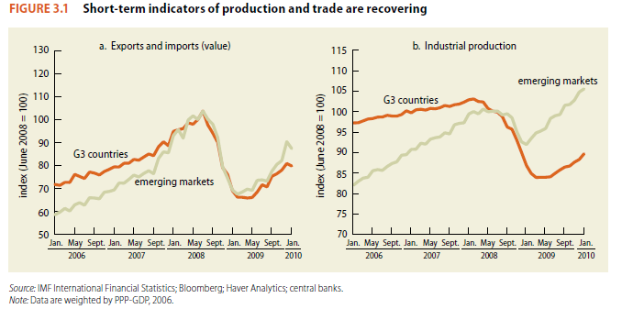
Despite massive trade shock from G3 downturn, developing economies declined less and recovered better

Slide 3
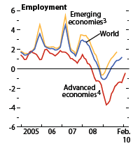
Unemployment rose in advanced economies, but not in emerging economies

Slide 4
Crisis and response
Crisis was an asset bubble collapse in US & EU, enabled and promoted by market and policy failures: with implications for global regulation
Transmission to developing countries was mainly financial; though some trade consequences of G3 slowdown, no protectionist pressure
Country policy response (especially among MICs) revealed new policy capacity, though based on self-insurance (reserves) and not coordinated

Slide 5
Emerging economies adopted a far more autonomous policy stance than in past crises
Reserve accumulation as (expensive) self-insurance after lessons of 1990s
Countercyclical macro-policies (fiscal, monetary and exrate) stabilise output
More extensive safety nets (universal rather than targetted) sustain demand

Slide 6
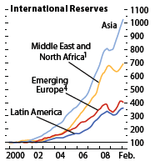
Massive reserve accumulation before the crisis acted as buffer

Slide 7
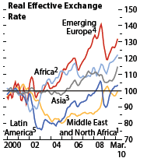
Real devaluations to accommodate shock were quickly rebalanced

Slide 8
What integration to global markets was supposed to offer
Integration of capital markets would pool risk and provide countercyclical access to those with “sound fundamentals” (it hasn’t)
Integration to world trading rules (WTO) would provide protection against protection in hard times (it has)
IFIs would act as lender of last resort for external trade/capital shocks (they haven’t)

Slide 9
Experience of the 1990s crises
Exchange rate targetting and volatile private capital flows led to loss of monetary policy control and asset bubbles
Major devaluations and high interest rates following shocks worsened crisis with procyclical effects
Followed by debate on how to separate domestic and global capital markets: capital controls or sterilization?

Slide 10
The new post-1990s defensive model
“Indirect” capital account controls through stricter bank regulation to prevent currency mismatch (“baht assets and dollar liabilities”)
Shift away from portfolio flows towards FDI (lengthens tenor and shares risk)
Accumulation of reserves to act as counter-cyclical buffer via sterilization (in both directions)

Slide 11
Successful counter-cyclical crisis management
Exchange rates float to accommodate shock, then return to target
Low interest rates stimulate domestic output and employment
Reserves used to balance forex market and avoid self-fulfilling exchange rate attacks

Slide 12
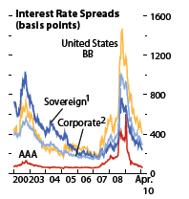
Interest spread (risk aversion) spike for emerging markets huge over two years

Slide 13
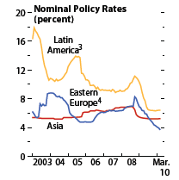
In contrast to the 1990s, interest rates were kept down

Slide 14
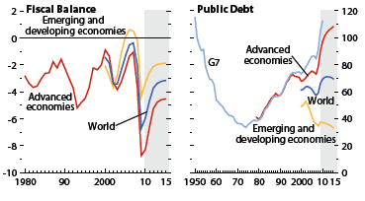
Temporary fiscal deficits sustained domestic demand, and debt contained

Slide 15
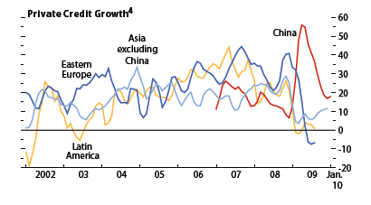
And private credit levels maintained and then increased

Slide 16
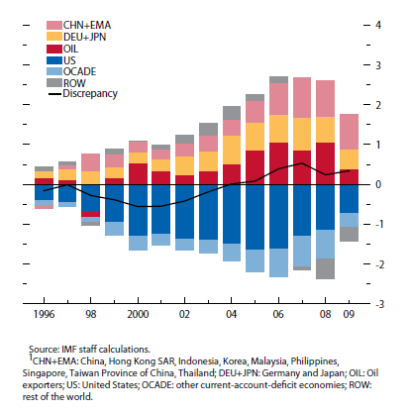
But recovery will be slow, global imbalances remain large

Slide 17
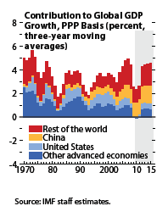
China and other large developing countries have become the “locomotives” of global growth

Slide 18
Global financial reform
No appetite in G20 (or G3 or G1) for fundamental reform or new institutions, especially now ‘worst is over’
Most to be expected: re-segmentation of markets, closer prudential bank regulation, control of OFCs and bailout fund levy
Issue is rather how to get rest of G20 included in new coordination systems; and create a permanent and recognized policy space

Slide 19
What do these initiatives have to offer to developing countries?
Designed to ensure US/EU capital market stability; will not even ensure $/€ stability
Do not address the depth of market access for developing country sovereign or corporate bonds (main financial shock transmission)
Would not support developing country banks (explicitly) or even subsidiaries of G3 banks in developing regions (implicitly)

Slide 20
What about regional arrangements?
Asia has independent policy stance and largest reserves; but also leadership rivalry
Latin America has reserves but highly dependent on the US; and politically divided (ALBA vs rest)
Africa financially underdeveloped and aid dependent; and very .
Only Eastern Europe can count on effective support from EU (to protect own banks)

Slide 21
In conclusion
Absent the restoration of the IMF to its original mandate:
  Adequate resources (SDRs not reserve pooling)
  Automatic liquidity provision (at penal rates)
  Voting by GDP shares (emerging 52%, US 21%)
Plus stronger regulatory powers for the BIS
The new model of national self-insurance (“capital protectionism”) is best option

